Slide 1
THIS GAME ROCKS
Notes:
Introduction (2)
Take off

Slide 2



Problem
STOCK PHOTOS
GET RICH FAST
FEAR
Notes:
What do you see at these pictures? This is how finance corps are trying to sell us stuff. As young professionals we will comment on that on behalf of our generation.
Shitty stock-photos, yeah. Very convincing.
Reports on how to get rich fast? Whoever believes in that in 2019?
Do you think playing with fear of poverty make us trust you? We want someone we can trust and no one who wants lecture us how to live. We already have parents that.
survey
Are you serious? Is this how you want to attract young people?
MLP is ready to change and we are here to show you how to connect to our generation. So how does the perfect solution should look like?

Slide 3



Concept
Notes:
Finance should be human-oriented – because we want to have a purpose
Engaging – because our attentionspan is very limited
Rewarding - generation of instant gratification
And thats why we came up with our solution this game rocks.

Slide 4


Slide 5




OUR SOLUTION
Gamification
Storytelling
Rewarding
Notes:
We asked ourselfes what could make us feel the need of managing our finances and most importantly that we need a mentor to guide us.
We all love games, because they allow us to experience the life of another person without risking anything. We like competing and sharing achievements of our success in social media.
Thats why our solution uses gamification to tell the story of people we can associate ourselfes with. But that‘s not everything. You, the player will interactively influence their lives with your decisions, earn rewards and get to know how to make that life possible. You can experience the positive results of long term decisions.

Slide 6


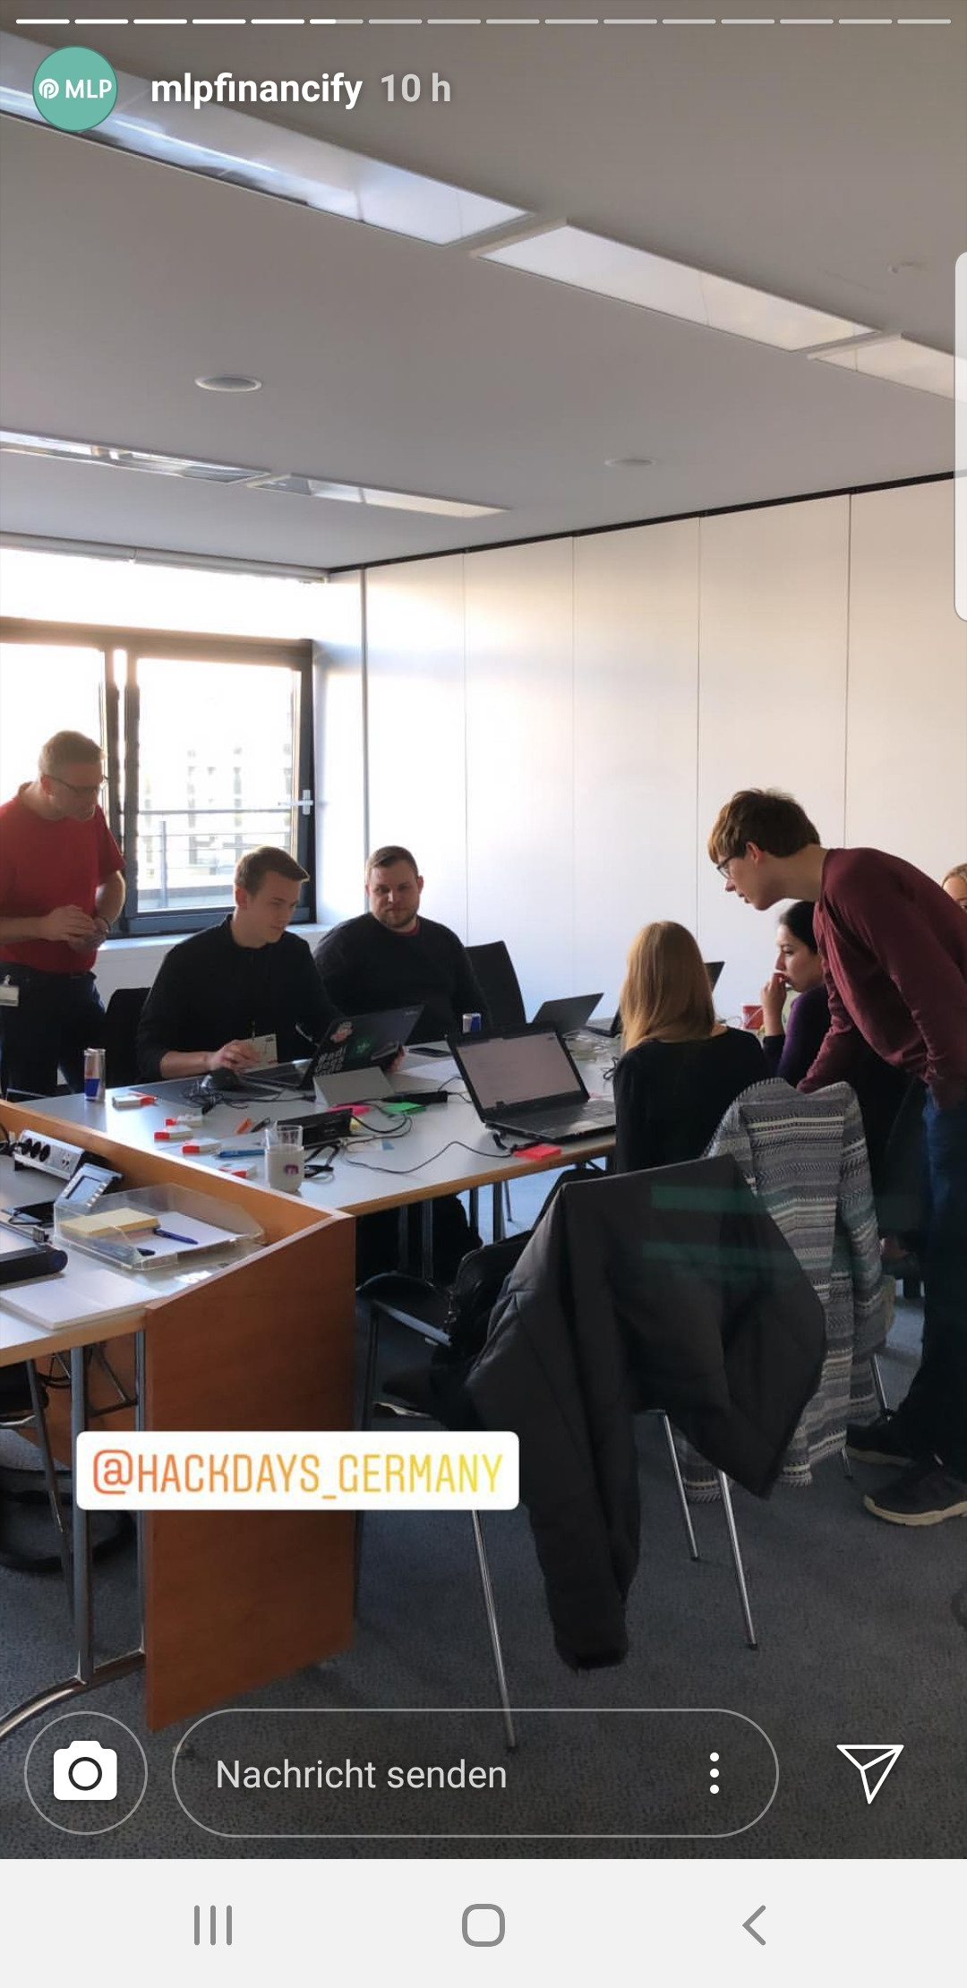

START
Influencer
Social Media
Banner/Website
Offline/Online
Notes:
Lets start the consumer journey.
First the consumer gets to know the game by influencers challeging thier followers beat their score. With only one swipe.
But we also make bold statements and give consumers the chance to identify with our brand through offline advertisement. For us the connection of online and offline is really important.

Slide 7
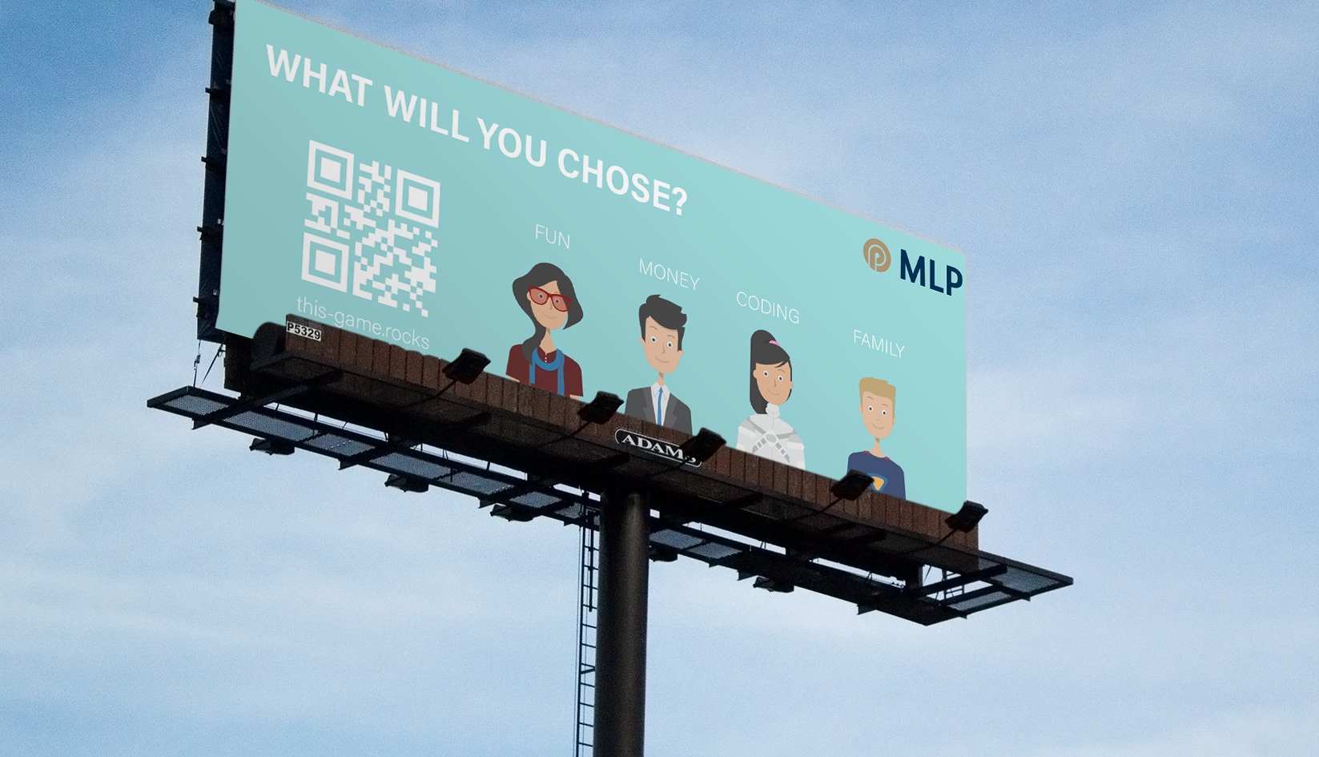
BE BOLD.
Notes:
Just imagine walking along the street and noticing the message that grabs your attention immediately. We as young professionals want to feel the bond with brands that are courageous and are not afraid of challenging the status quo

Slide 8


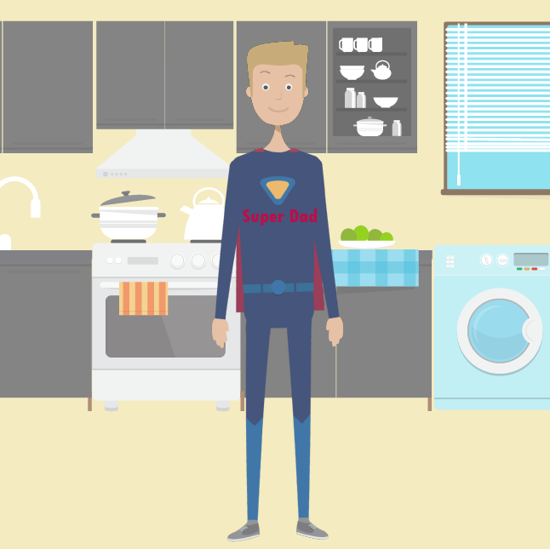


Character
Picks Journey
Game
Simulates Life
Pick Tina
Notes:
We give curious consumers a chance to pick a character which they can identify themselves with. All the characters have their own values and goals, and thus they have to make different decisions in life.
For example, Tina the Traveller, who wants to explore the world and prone to spontaneous purchasing. She is living in the now and not thinking about her future.
Once you have chosen the character, you guide him through his life‘s journey. All your choices will have the consequences, and the final achievement of the life goal will depend only on your decisions.

Slide 9



You Rock!
Results
Call to action
Join the club!
By clicking the button cou accept our privacy policy.
LEAD
Notes:
In the end of the game there will be an image generated based on the final score. This you can share with your friends and challenge them to beat your score.
But the real goal of the game is to make users realize how huge the impact of their financial decisions is, and make them eager to ask for the guidance and clever mentorship with their own finances. And oh, luckily there is a lovely button to get in touch with MLP just below the result! Awesome, isnt it?

Slide 10

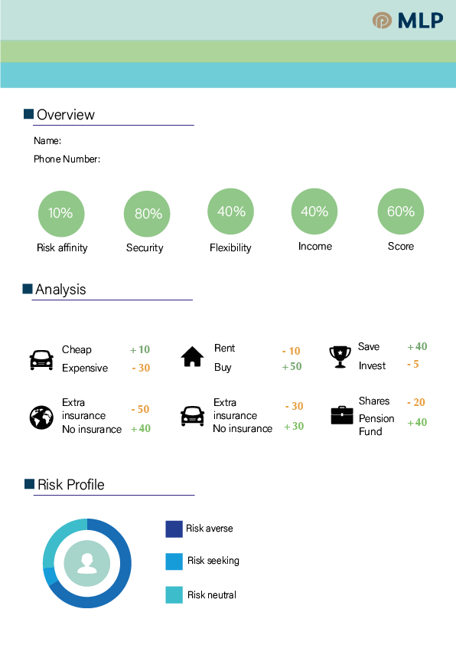
Zoe Müller
+49 8166 2918 291
For consultants
Notes:
During the game data will be collected and automaticly transformed into the risk profile of each player. This will be further visualized and used by MLP consultants to know their consumers even before the first contact. For example, the consultant can establish the trust in an easy manner by breaking the ice with congratulating on the great result.

Slide 11
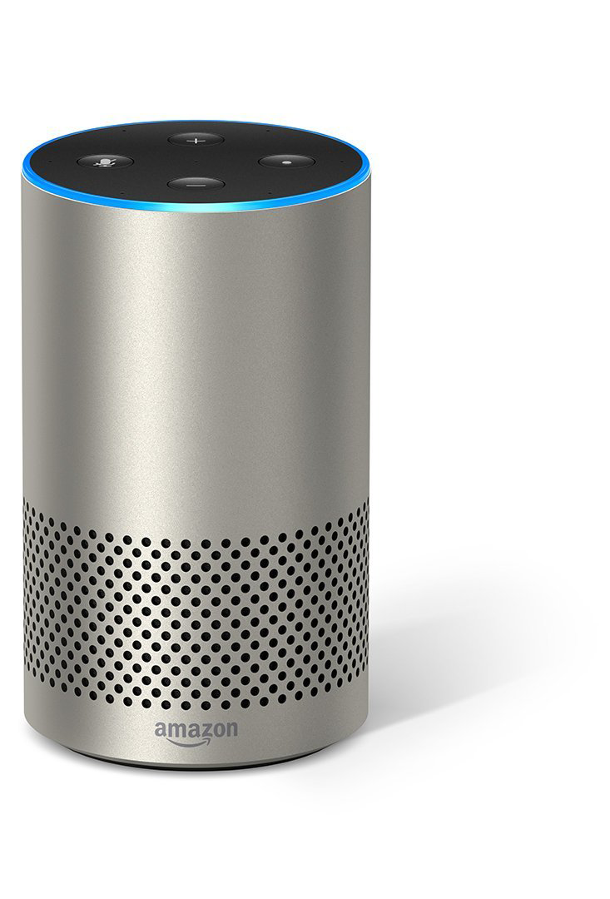
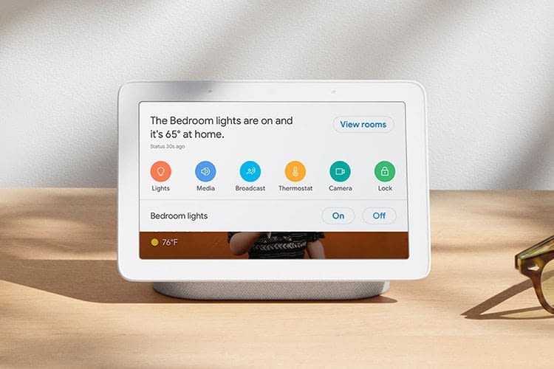
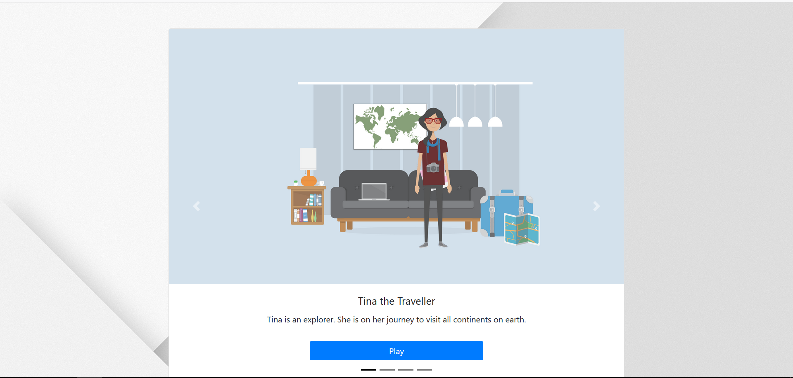
Future? Voice-controlled!
Notes:
When I talk to my nephew who is 6 years old, I notice that he
The fture generation will ust imagine talking with a person#
Yes or No

Slide 12

Future? Consumer-centric!
Chose your destiny.
Chose your destiny.
?
?
?
?
?
Pick ???
Notes:
-But we will not stop on this! The future is personalized. Imagine scanning your face and actually appearing as a cartoon characted in the game. Moreover, in the end you will see the cartoon face of the consultant from your region.

Slide 13
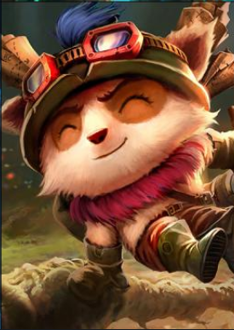
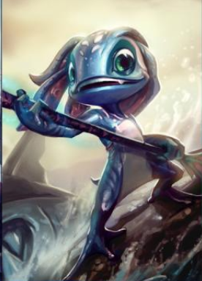
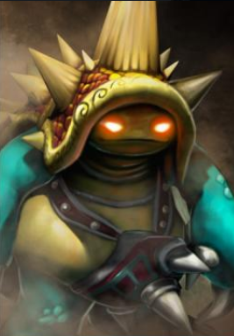
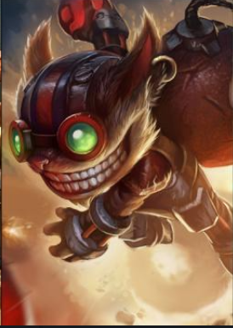
Future? E-Sports!
Chose your destiny.
Chose your destiny.
Pick Ziggs
Notes:
- Okay, there are the basics. But can we go further?
Of course we can! We looked and the principles of MLP and realized that e-sports is a part of them. Imagine the next MLP League of Legends Cup. Gamers will be thrilled to compete in the new game, playing their favourite champions. The stories of the champions have a great potential to build engaging storytelling.
Interesting, I have been playing 5 years and I can say for sure I would love it.

Slide 14
MORE REACH
MORE ENGAGEMENT
MORE ANALYTICS
Notes:
So, to summorize it, these are the main three point we want you to take away from this pitch. Our solution will generate more reach, engages customers and provide MLP withmore analytics of the target audience.
Attention. Thank you for attention.

Slide 15

www.this-game.rocks
Notes:
So, time the demo.

